Slide 1
Exploring R Programming: An In- Depth Overview of Language Structure, Data Types, and Scope

Slide 2






Introduction to R Programming
is a powerful language designed for statistical computing and graphics. This presentation will provide an in-depth overview of its
, , and .
Understanding these concepts is essential for effective data analysis and visualization in R.

Slide 3


Language Structure of R
R's combination of and
is based on a
. It
allows for both procedural and modular coding styles, making it ﬂexible for various applications in data analysis and statistical modeling.

Slide 4

Names and bindings in R
In R, names are identifiers for variables and functions, with bindings establishing the relationship between names and their values. The scope defines the visibility of these names, determining where they can be accessed within the program.

Slide 5

Data Types in R
R offers several data types including vectors, lists, matrices, and data frames. Each type serves a specific purpose and is crucial for data manipulation. Understanding these types enhances data handling capabilities and optimizes performance.

Slide 6

Factor Data Type
Factors in
R are used to represent
categorical data, storing levels of categories for analysis. They are crucial when performing statistical modeling and can improve efficiency by saving memory while ensuring data integrity.

Slide 7

Scope in R Programming
The concept of scope in R defines the visibility and lifetime of variables. There are different types of scope such as global, local. Knowing how scope works is vital for managing data and avoiding conﬂicts in your code.

Slide 8

Expressions and assignments in R
R programming employs expressions to evaluate and produce values, as
well as assignment store these
statements to in variables.
values
these concepts is
Understanding
crucial for writing effective R code.

Slide 9

Understanding Expressions
In R, an expression is a combination of variables, constants, and operators that yields a value. Expressions can be simple, like arithmetic operations, or complex, involving functions and control ﬂow.

Slide 10

Assignment Statements
Assignment in R is done using the assignment operator '<-' or '='. This allows values to be stored in variables, which can be used later in expressions or function calls, enhancing code reusability. The operator ‘<<-’ can be used for assigning a global scope to the variable.

Slide 11

Control Structures
Control structures in R, can be broadly divided into 3 categories:- conditional, looping and switch statements. They allow developers to create conditional logic and repeat actions, enhancing program functionality.

Slide 12
Object Oriented Programming in R
R supports object-oriented programming through both S3 and S4 class systems, allowing for more structured and modular code. This ﬂexibility enhances code usability and maintainability in complex data analyses.
OOP in R is particularly useful for developing packages and building complex data structures, helping to maintain organized and reusable code.

Slide 13
Three main OOP systems
S3: A lightweight and ﬂexible system, where methods are assigned to classes using generic functions
like print() or summary(), and classes are defined by assigning a class attribute to an object.
S4: A more formal system that allows for strict class definitions and method signatures, offering better data validation through setClass() and setMethod().
R6: This is a modern, mutable OOP system in R, similar to
traditional OOP in languages like Python, allowing for encapsulated methods and fields.

Slide 14
Methods and Inheritance
R allows method overloading through the use of S3 and S4 systems, enabling functions to behave differently based on the object's class. Inheritance in S4 promotes code reusability, allowing subclasses to inherit features from their parent classes and extend functionalities.
Inheritance in R is supported primarily in the S4 and R6 systems, allowing new classes to inherit properties and methods from existing classes, promoting code reuse and extending functionality.

Slide 15
Usage of objects in R
Objects in R encapsulate data and behavior, enabling the creation of complex data structures that simplify data manipulation. This encapsulation enhances the readability and maintainability of R code, allowing users to build more organized and efficient data analyses.
Objects are used to encapsulate data and behavior, making it easier to organize and reuse code, especially when working with custom classes and methods in object-oriented programming.

Slide 16

Advanced features of R
R programming offers advanced features that significantly enhance its functionality, including concurrency, exception handling, event handling, and functional programming concepts. These features allow R to manage complex tasks efficiently while providing robust tools for error management and programming ﬂexibility.

Slide 17
Concurrency in R
Concurrency in R allows for the simultaneous execution of tasks, improving performance, especially for computationally intensive operations. The `parallel package enables users to leverage multi-core processors, facilitating faster data analysis and model training.
Concurrency in R is enabled through packages like,, and, allowing R to perform computations across multiple CPU cores or nodes for faster execution

Slide 18

Exception Handling
R provides robust exception handling using
`try(),`tryCatch(),`and `withCallingHandlers(),`
which allow users to manage errors gracefully. This ensures that the program continues to run, enabling developers to log errors or recover from issues smoothly.

Slide 19
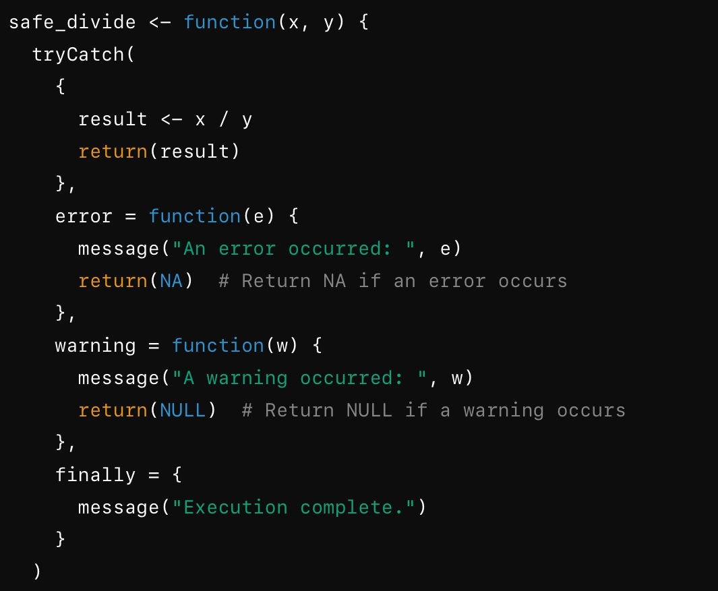
Example code of exception handling

Slide 20
Event Handling
Event handling in R enables the creation of interactive applications, where user actions can trigger specific responses within a program. This feature is crucial for developing user-friendly graphical applications using packages such as s`hiny`and `Rcpp.`
In, event handling allows the application to respond to user interactions, such as button clicks, slider movements, or input changes. Functions likeandmonitor specific user actions and trigger code to execute when those actions occur, enabling dynamic and interactive user interfaces. This event-driven behavior is key for building responsive dashboards and web applications, making R suitable for creating interactive data analysis tools.

Slide 21
Functional programming concepts
R is built on functional programming principles, allowing functions to be treated as first-class objects. This enables higher-order functions, enabling users to pass functions as arguments and utilize closures for more expressive programming.
R is well-suited for functional programming, as we have discussed functions are treated as first-class citizens, meaning they can be assigned to variables, passed as arguments, and returned from other functions. This allows for the creation ofhigher-order functionsthat can accept other functions as inputs, such as,, and, enabling concise and efficient data manipulation.

Slide 22




Applications of R
R is widely used in various domains such as , , and
. Its extensive package ecosystem supports a range of
applications, making it a preferred choice for data scientists and statisticians
worldwide.

Slide 23




Conclusion
In conclusion, R programming is a versatile tool for data analysis. Understanding its
, , and
is essential for leveraging its full potential. As the demand for data-driven insights grows, mastering R will be invaluable.

Slide 24



Estimating the scale of natural calamities based on temperature reading

Slide 25
Objective
The objective of estimating the scale of natural calamities based on temperature readings is to identify patterns and relationships between temperature variations and the occurrence or severity of events like heatwaves, droughts, hurricanes, or wildfires. By analyzing temperature data over time, this estimation aims to develop predictive models that can forecast the likelihood or intensity of such events, improving early warning systems and risk assessment. This can help in better preparedness and response planning, minimizing potential damage, and informing policymakers and disaster management agencies to take timely actions to protect lives and infrastructure.

Slide 26
Features
Data driven analysis: Analyzing temperature data can be enhanced by incorporating other climate metrics such as humidity, pressure, and wind speed to predict natural disasters like heatwaves, droughts, and indirectly related phenomena like storms or wildfires.
ML and statistical model: Predicting extreme temperature patterns and their potential impact on natural disasters can be accomplished using techniques such as time-series analysis, regression models, and machine learning algorithms like neural networks and decision trees.

Slide 27
Constraints
Data quality and availability: The precision of estimations relies on the availability of detailed and long-term temperature data, which may be lacking in certain areas, causing gaps in forecasts or regional bias in modeling.
Complex interaction of variables: The occurrence and severity of natural disasters are inﬂuenced by numerous variables, with temperature being just one of them.
Model Uncertainty: There is inherent uncertainty in estimating the severity of
disasters, particularly in complex natural systems where slight temperature variations can lead to different outcomes.

Slide 28
Technologies that will be used
Time Series Analysis models like ARIMA, LSTM(Long Short-Term
Memory networks), and RNNs(Recurrent Neural Networks) can analyze historical temperature data to predict future trends and potential extreme temperature events.
Classification models(e.g.,Random Forests, Gradient Boosting Machines) can be trained to identify patterns associated with natural calamities like heatwaves, wildfires, and droughts.
GIS(Geographic Information Systems) tools like ArcGIS and QGIS are used to visualize and analyze temperature data spatially.

Slide 29
Practical applications
Predicting Heatwaves and Managing Public Health Forecasting Wildfires
Modeling and Predicting Storm Intensity Assessing Drought Conditions
Glacial Melt and Flood Risk Management

